Slide 1
Applying for Oral Health Sciences
A summary of the
application process
www.ed.ac.uk
applyedinburgh

Slide 2
Standard academic entry requirements
Most common
SQA Qualifications: Nat 5 – English at grade B. 4 x SQA Highers at Grade B to include Biology or Human Biology
GCE Qualifications: GCSE – English at grade 4/C. 3 x A Levels at grades BBB to include Biology or Human Biology.
International Baccalaureate: 32 points overall (incl TOK & EE) including 555 at HL including Biology; plus SL English at grade 5.
SWAP Access to Biomedical/Medical Sciences: AAB (Biology must be at grade A)
Dental Nursing qualifications are accepted along with one of the following: SQA Highers at BBB to include Biology/Human Biology; GCE A Levels BB to include Biology/Human Biology
Other Access courses may be considered on a case by case basis by contacting the UG admissions team at: oralug@ed.ac.uk
We also accept a range of European qualifications and requirements can be
Found here: https://www.ed.ac.uk/studying/international/country
www.ed.ac.uk
applyedinburgh

Slide 3
Personal statements
Personal statements are assessed alongside academics (achieved and predicted). We are looking for the following:
Personal qualities and skills that you possess
Evidence of career exploration which may include:
Work experience/shadowing in a dental setting
Evidence of exploration of dental hygiene-therapy practice through: Previous studies; discussion with professionals and scope of practice within dental hygiene-therapy; reading relevant to regulatory/professional bodies and/or papers related to oral health
(We value quality of experience over quantity and look for clear evidence of reflection on experiences gained).
Non-academic achievements and interests
We know work experience/shadowing may be difficult during these challenging times; just get what you can when you can and remember: you can read articles/blogs/listen to podcasts or watch online talks too!
www.ed.ac.uk
applyedinburgh

Slide 4
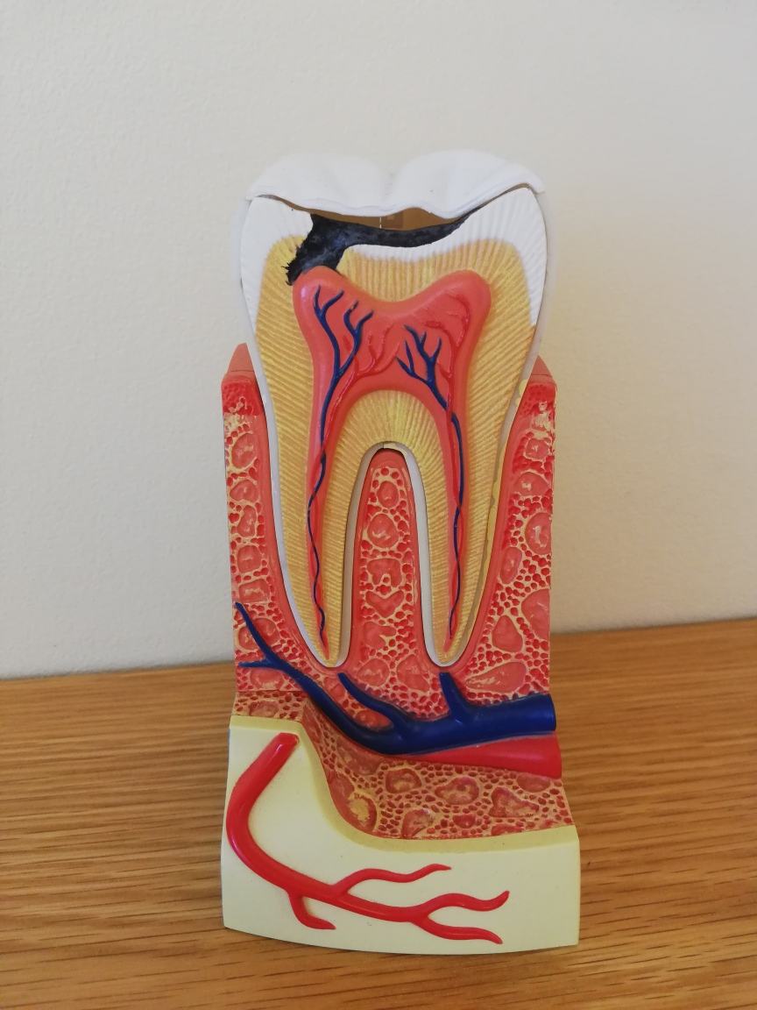
Widening participation
We offer extra support for applicants who:
Are care experienced
Reside in geographical areas defined as “deprived”
Attend a school of low progression to Higher Education and / or low attainment
Have significant caring responsibilities
Are refugees or asylum seekers
Have participated in recognised access programmes (ie SWAP)
www.ed.ac.uk
www.ed.ac.uk
applyedinburgh
applyedinburgh

Slide 5
Further information:
Widening Access offers
Eligibility criteria for our contextual “flags”:
www.ed.ac.uk/studying/undergraduate/access-edinburgh/widening-access-offers
Online Widening Access eligibility checker:
https://admission-checker.is.ed.ac.uk/
Degree Finder (outlining the minimum academic entrance requirements for Widening Access applicants):
www.ed.ac.uk/studying/undergraduate/degrees
www.ed.ac.uk
applyedinburgh

Slide 6
What happens to my application?
Overview
How we receive your application - UCAS
Assessing your application: Screening Academics & personal statements
Unsuccessful Applications
Interviews
Decision making – Offers
Post offer
www.ed.ac.uk
applyedinburgh

Slide 7
How we receive your application
www.ed.ac.uk
applyedinburgh

Slide 8
Assessing your application
Screening
The weightings that we apply to each area of an application are as follows:
Academics +
Personal Statement = 40%
Interview = 60%
Our team check all the applications to make sure they meet the entry requirements before all are assessed by two members of staff independently
If we need clarification of any details or missing information we will contact you through EUCLID for further information.
Euclid sends automated emails so please regularly check your EUCLID portal for updates and requests for information
Approximately 70 applicants will be shortlisted to attend an interview (owing to Covid-19 some or all of these may be conducted remotely for 2021 entry)
www.ed.ac.uk
applyedinburgh

Slide 9
Unsuccessful applications
What to do next
Ask for feedback
Other universities may look for different requirements in their students – see which would give you the best chance of success
If your academic grades don’t meet; consider re-taking your examinations or look at a suitable access course.
www.ed.ac.uk
applyedinburgh

Slide 10
Interviews
Ordinarily, these would take place in person at Edinburgh Dental Institute. However, due to current disruption caused by the Covid-19 pandemic we are not in a position at present to confirm if we will be running face-to-face sessions or if some/all sessions will be undertaken remotely.
Due to take place in February 2021.
Structured in a multiple mini-interview format
Applicants are assessed on the following five test types: career exploration; leadership & management; professionalism; manual dexterity; communication
www.ed.ac.uk
applyedinburgh

Slide 11
Decision making
After the interviews have taken place we review total application scores.
We calculate how many offers we are going to make dependant on the number of places available
All offers are made via UCAS and are all conditional as even if exam results are already achieved you must successfully become a member of Disclosure Scotland’s Protecting Vulnerable Groups scheme.
We typically have more applications than we have places available.
www.ed.ac.uk
applyedinburgh

Slide 12
Post offer
What happens now?
If accepting the offer as firm
You’ll receive guidance on how to complete your PVG application
You’ll be asked to upload scanned certified copies of documents
Apply for accommodation
If accepting the offer as insurance
Nothing further to do at this time
We will contact you further if you then make us your firm choice.
www.ed.ac.uk
applyedinburgh

Slide 13
And finally…
Exam Results – July/August
Confirmation – have you met the conditions of your offer?
Edinburgh Dental Institute communication – issued to firm applicants who meet their conditions of offer.
Welcome Week - introduce you to Edinburgh and the Dental Institute.
Congratulations – you did it!
www.ed.ac.uk
www.ed.ac.uk
applyedinburgh
applyedinburgh

Slide 14
Useful website
Oral Health Sciences website:
https://www.ed.ac.uk/dentistry/undergraduate-study
Any questions?
Please email
oralug@ed.ac.uk
www.ed.ac.uk
applyedinburgh

