Slide 1
Diversity & inclusion at Wellcome
Jim Smith, Director of Science

Slide 2
Good health makes life better. We want to improve health for everyone by helping great ideas to thrive.

Slide 3

Wellcome strategic approach
Advancing ideas
Seizing opportunities
Driving reform

Slide 4

Improve health through the best research
Creating knowledge
Strengthening research capability
Using knowledge effectively
Promoting an environment in which research can flourish

Slide 5
Improve health through the best research
Creating knowledge
Strengthening research capability
Using knowledge effectively
Promoting an environment in which research can flourish

Slide 6
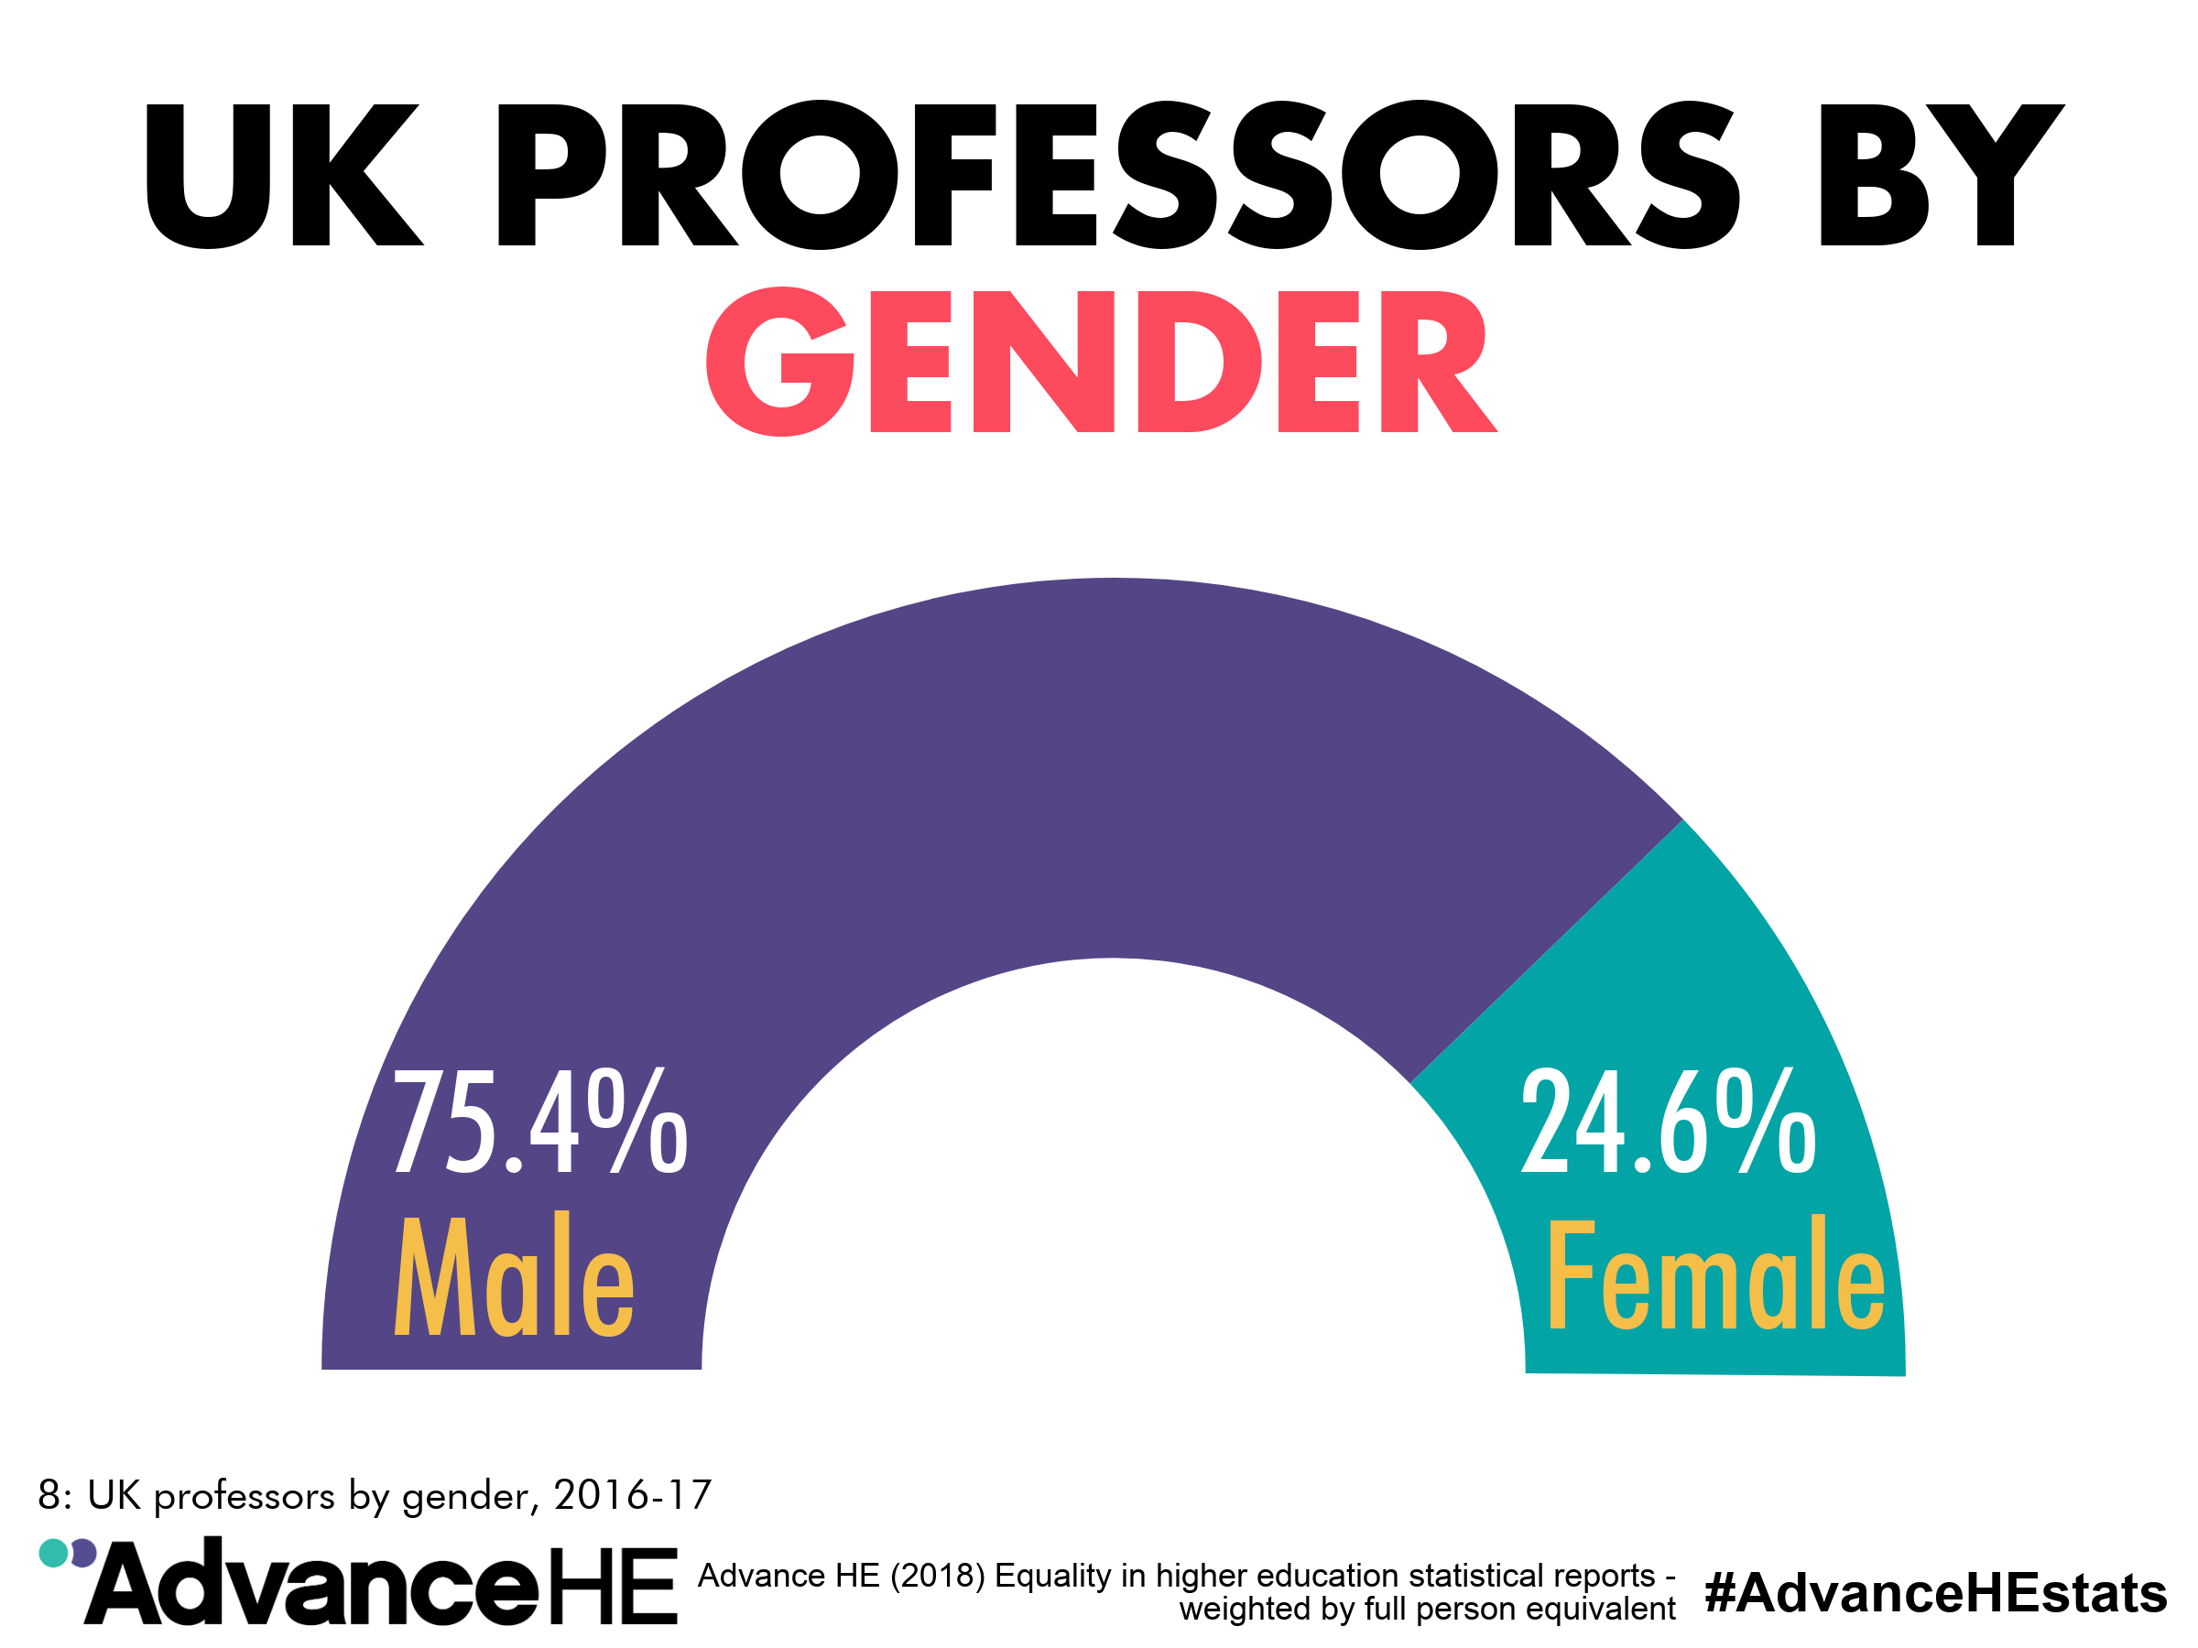

Slide 7
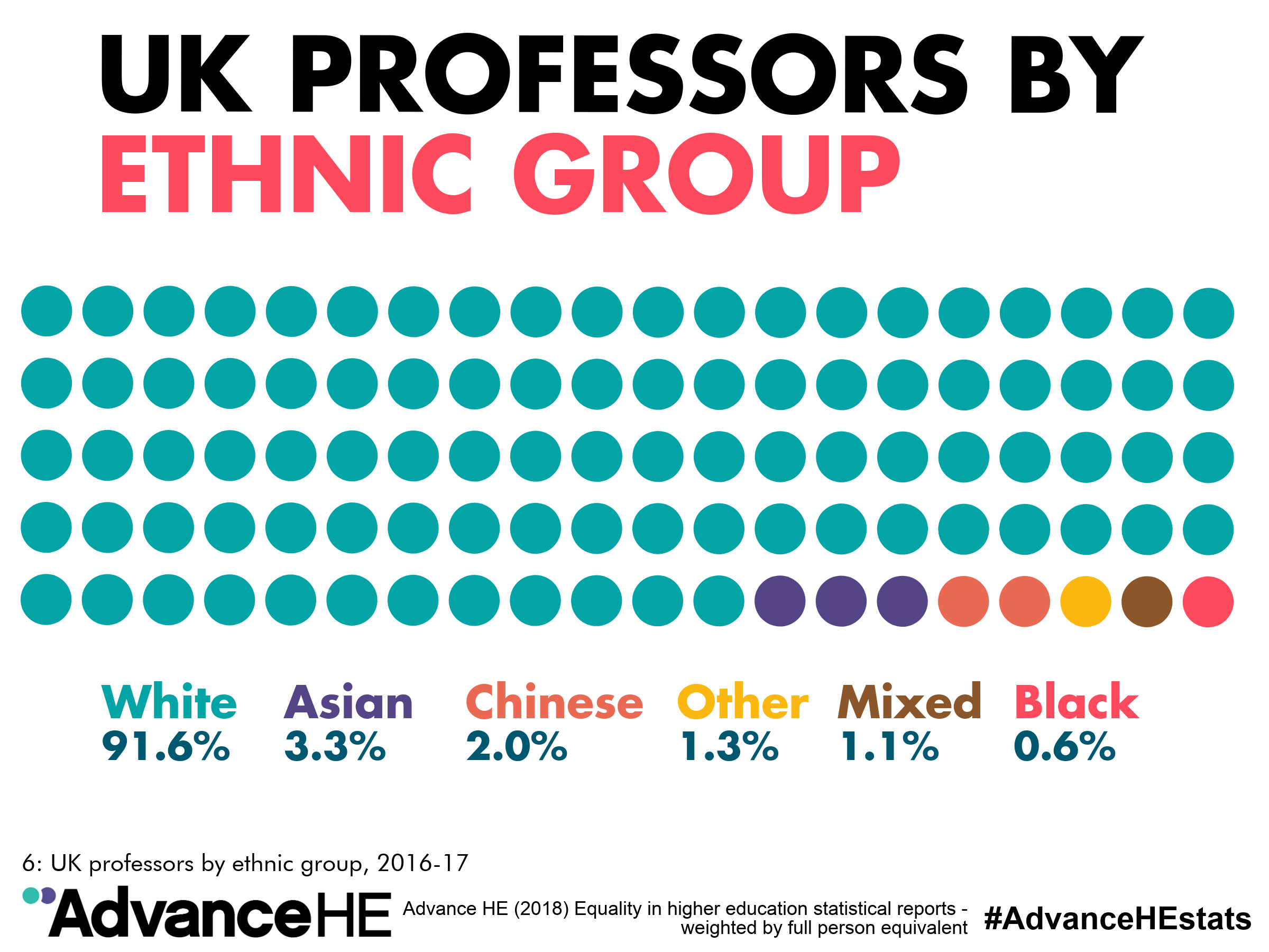

Slide 8
Tough problems don’t get solved by monolithic thinking. Collaboration is key to scientific progress and that needs true inclusion of great diversity
Patrick Vallance
Government Chief Scientific Adviser

Slide 9
I found pulsars because I was a minority person and feeling a bit overawed at Cambridge. I was both female but also from the north-west of the country and I think everybody else around me was southern English…So I have this hunch that minority folk bring a fresh angle on things and that is often a very productive thing. In general, a lot of breakthroughs come from left field.”
Jocelyn Bell Burnell
Breakthrough Prize winner

Slide 10
Diversity & Inclusion at Wellcome

Slide 11
Wellcome strategic approach
Advancing ideas
Seizing opportunities
Driving reform

Slide 12
Diversity and inclusion at Wellcome
£12.5m
We are missing out on talented people with great ideas. We want to change this because it’s the right thing to do, and vital to meeting our mission to improve health for everyone
5 years
Diversity and inclusion is one of Wellcome’s strategic priority areas
The work isn’t entirely new, but the strategic focus is
We can’t improve health for everyone by helping great ideas to thrive if we don’t take D&I seriously
We have a responsibility to use our influence to speed up progress

Slide 13

Diversity & Inclusion
What is “diversity” at Wellcome?
Broad definition…
More than a focus on women in science
We need to remember complexity of the task: no silver bullet

Slide 14
Our approach
We want sustainable change. We focus on…
Removing barriers facing people at Wellcome
Removing barriers facing people in science and research field
Incentivising leadership in diversity and inclusion at all levels*
Our Workstreams
UK science and research
Society
Wellcome
*Note for Jim

Slide 15
Wellcome grant funding
Wellcome grants 2016-17: gender profile

Slide 16
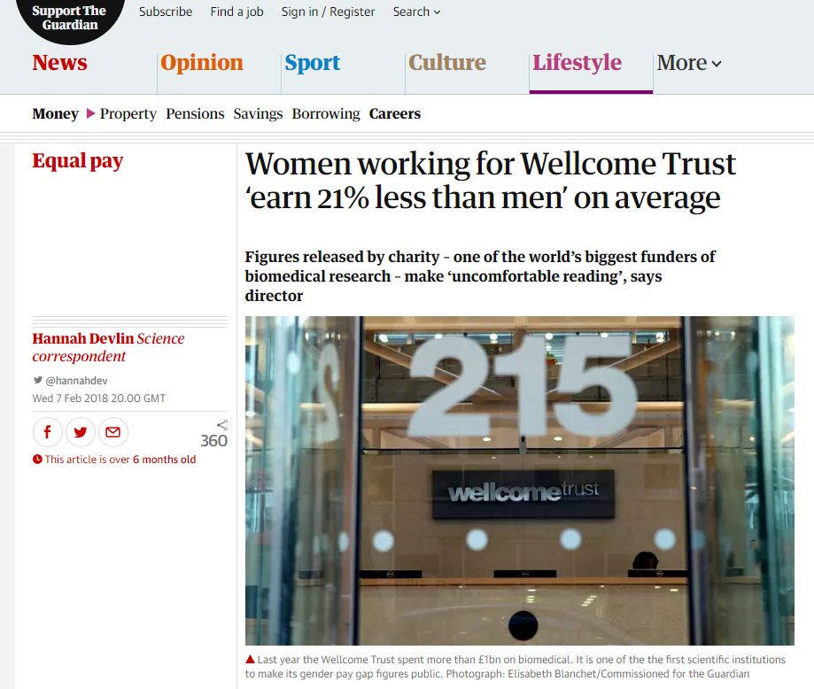
Gender pay gap
[the figures] inevitably make uncomfortable reading. An organisation has to face up to uncomfortable things and say we’re not where we want to be and we want to change that.
Jeremy Farrar, Director

Slide 17
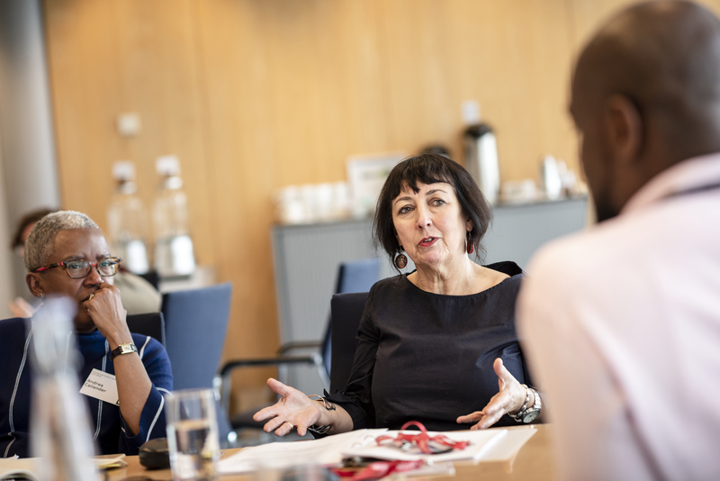
What have we done so far?
Commissioned & published research into diversity challenges
Established a steering group to advise on our work
Funded minority researcher networks and events
Partnered with the Brilliant Club
Launched Research Enrichment Scheme

Slide 18

Research Enrichment Scheme
Aim: To provide additional funding to help Wellcome grant holders to try new approaches to diversity and inclusion
Examples of what we expect to fund
Considering diversity at the planning stage
Supporting underrepresented groups in specific fields
Organising accessible conferences

Slide 19
What’s next for D&I at Wellcome?

Slide 20
Forthcoming D&I activities
Improve support we provide to disabled grant holders
Unconscious bias training for Wellcome staff
Launch a D&I research programme to develop evidence for what works—this is really important*
Consider introduction of D&I grant conditions
*Note for Jim

Slide 21
Thank you
j.smith@wellcome.ac.uk and g.tracey@wellcome.ac.uk

Slide 22


@edisgroup
www.edisgroup.org

Slide 23
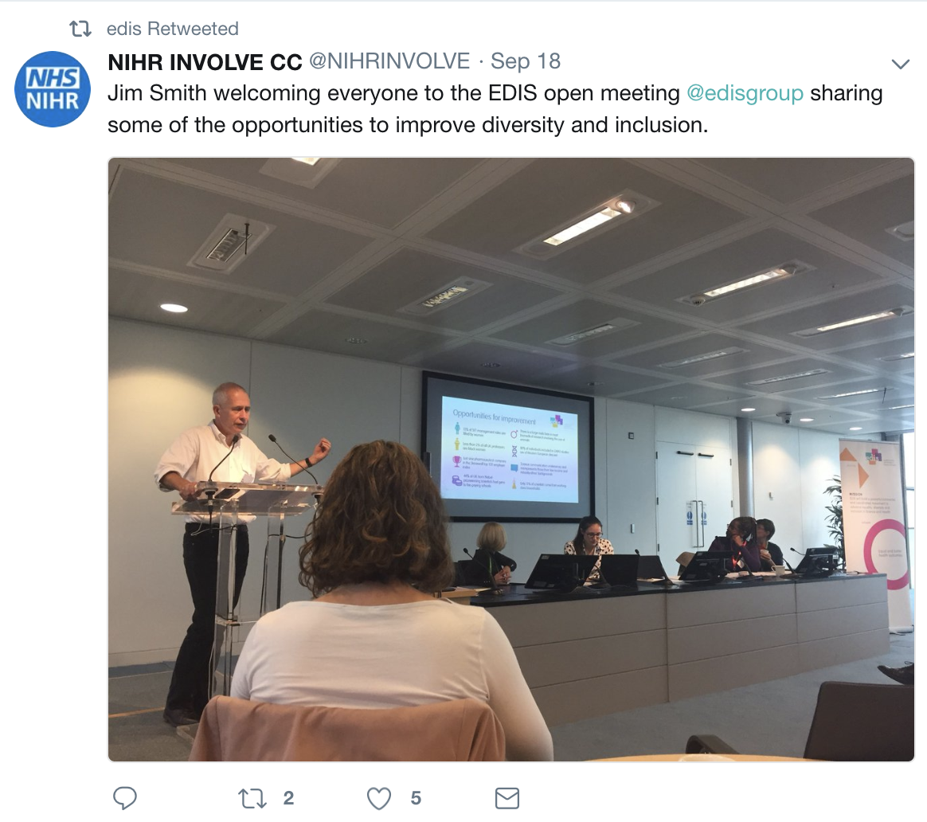
Inaugural meeting on Tuesday

Slide 24
EDIS—the story so far
September 2017: EDIS symposium
November 2017: EDIS Project Manager starts – Identifying the barriers and opportunities
March 2018: First EDIS interim board meeting. Agreed founding document, scope and principles
May 2018: Second EDIS interim board meeting. Workshop to develop theory of change to inform strategy
July 2018: Third EDIS interim board meeting. Agreed upon opening out membership and first actions
September 2018: Open EDIS meeting to recruit additional partners

Slide 25








Opportunities for improvement
15% of SET management roles are filled by women
There is a large male bias in most biomedical research involving use of animals
Less than 2% of all UK professors are black women
80% of individuals included in GWAS studies are of Western European descent
Just one pharmaceutical company in the Stonewall top 100 employer index
Science communication underserves and misrepresents those from low income and minority ethnic backgrounds
44% of UK-born Nobel-prizewinning scientists had gone to fee-paying schools
Only 15% of scientists come from working-class households

Slide 26
EDIS brings everyone together
Charities
HEIs
Public
Research institutes
Funders
Commercial
Societies

Slide 27

EDIS brings everyone together

Slide 28
What we want to do
Vision
For everyone to have equal opportunities and access to a successful career within Science or Health, its research and its outcomes.
Mission
EDIS will build a powerful, connected and coordinated movement to advance equality, diversity and inclusion in Science and Health.
Impact
Equal and better health outcomes

Slide 29
Benefits
Combine its resources to scale up successful initiatives
Have access to a greater collective influencing power
Show a public, collaborative commitment to improving the diversity and inclusivity of UK Science and Health
Avoid replication and coordinate sector-wide efforts efficiently
Contribute to the full picture of diversity and inclusivity in UK Science and Health
Benefit from the network’s shared expertise, research and experience

Slide 30
Call for members
EDIS aims to become an independent charity
EDIS needs members and funders
EDIS is a ‘start-up’; we will need seed funding, organisations willing to invest who see the potential
Varying sizes of organisations will mean varying resources that can be invested—talk to us about what is possible
£300k will cover staff, research, events, grant(s), engagement and outreach activities for year one

Slide 31
Thank you
j.smith@wellcome.ac.uk, g.tracey@wellcome.ac.uk, lilian.hunt@outlook.com

