Slide 1
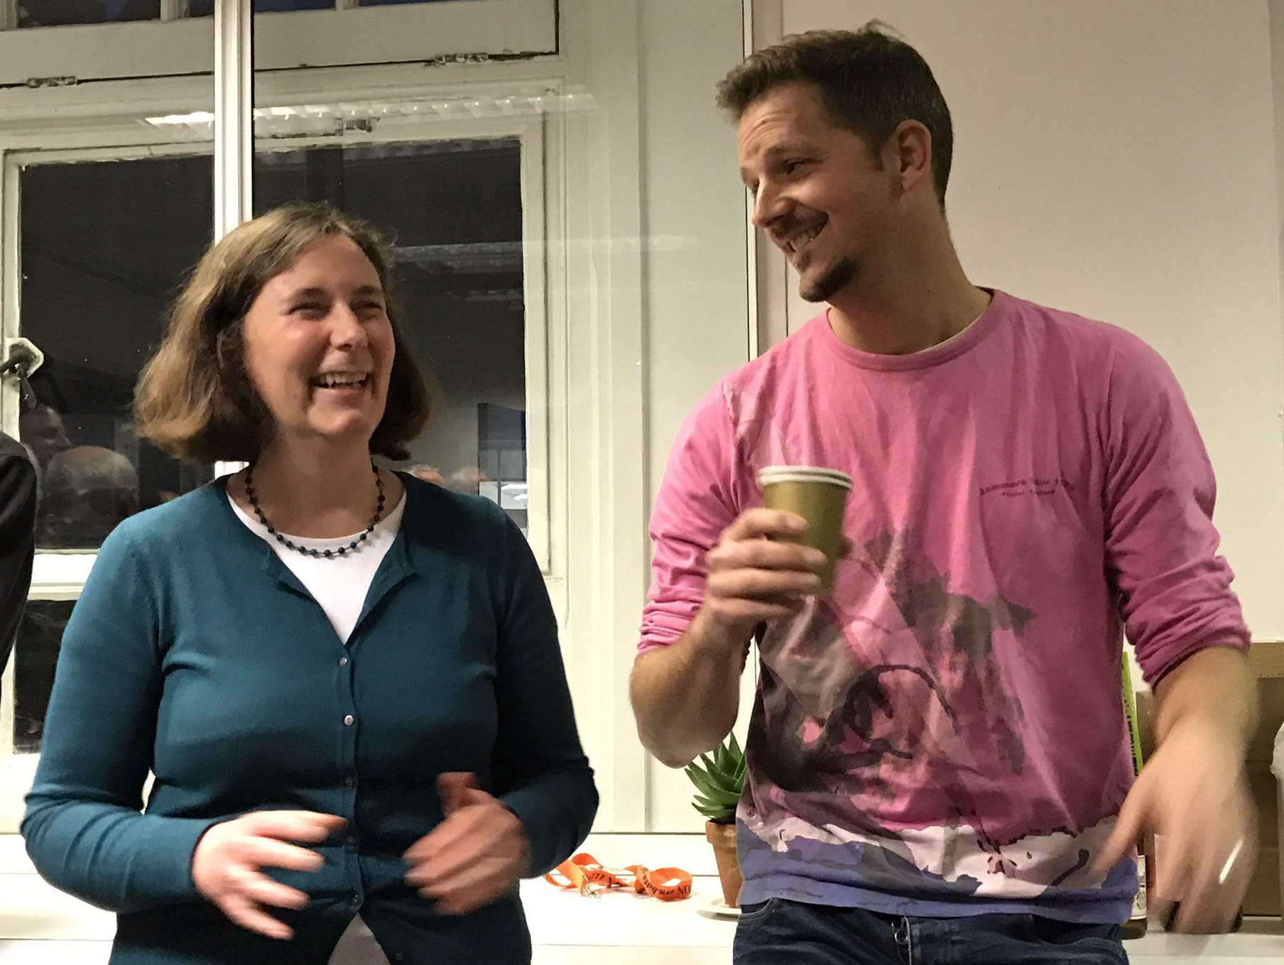
How we found Gold at UCL: Leading the way by simply good practice
Sara E. Mole
Provost’s Envoy for Gender
Equality
Great Ormond Street Hospital Children’s Charity Professor 2017-2020
MRC Laboratory for Molecular Cell Biology
University College London

Slide 2
LMCB: Aiming for fairness & excellence = aiming for Gold
Engage
2008
Silver 2009
Silver 2012
Gold 2016
Gold.......
4 things made the difference
‘Mantra’ - Simply good practice
SAT/Athena Steering Group
Understanding process of cultural change
Targeting where we could have most effect
Increase awareness, positive action, role models
Using Athena SWAN to drive process of cultural change
Notes:
Adopting a mantra
Understanding the process of cultural change
Amazing ASG
Prioritising

Slide 3
8-step process of cultural change to embed principles and practices
Step | Description | Examples at the LMCB
1 | Establishing a sense of urgency | Linking funding to Silver award; Wanting to be the best at what we do (i.e our science) and to be the first to win Silver (2009) then Gold (2016)!
2 | Forming a powerful guiding coalition | The Athena Steering Group.
3 | Creating a vision | Mantra ‘simply good practice’.
4 | Communicating the vision | Embedding Athena updates in LMCB meetings; new website, many events, triennial Surveys.
5 | Empowering others to act on the vision | New procedures (appraisal, minutes, action tracker); New tools (list of female seminar speakers, career timelines, postdoc & student groups etc); New actions (encouraging female applications for GL positions, supporting extension fellowships etc).
6 | Planning for and creating short-term wins | Nominations for awards whenever possible; Annual promotions, bonuses and fellowship successes; Athena awards every 3 years. Kudos within UCL.
7 | Consolidating improvements & producing still more change | Surveys; ASG implementing improved Silver actions and new actions; Developing Gold Action Plan; Helping others; Sharing the mantra wherever we are.
8 | Institutionalising new approaches | LMCB acting as Champion and demonstrating Beacon activities – speaking, consultation, reading draft applications. ASG procedures & actions considered best practice throughout LMCB and emulated. UCL & elsewhere:
Kotter HBR 2007
Notes:
8 yrs.

Slide 4
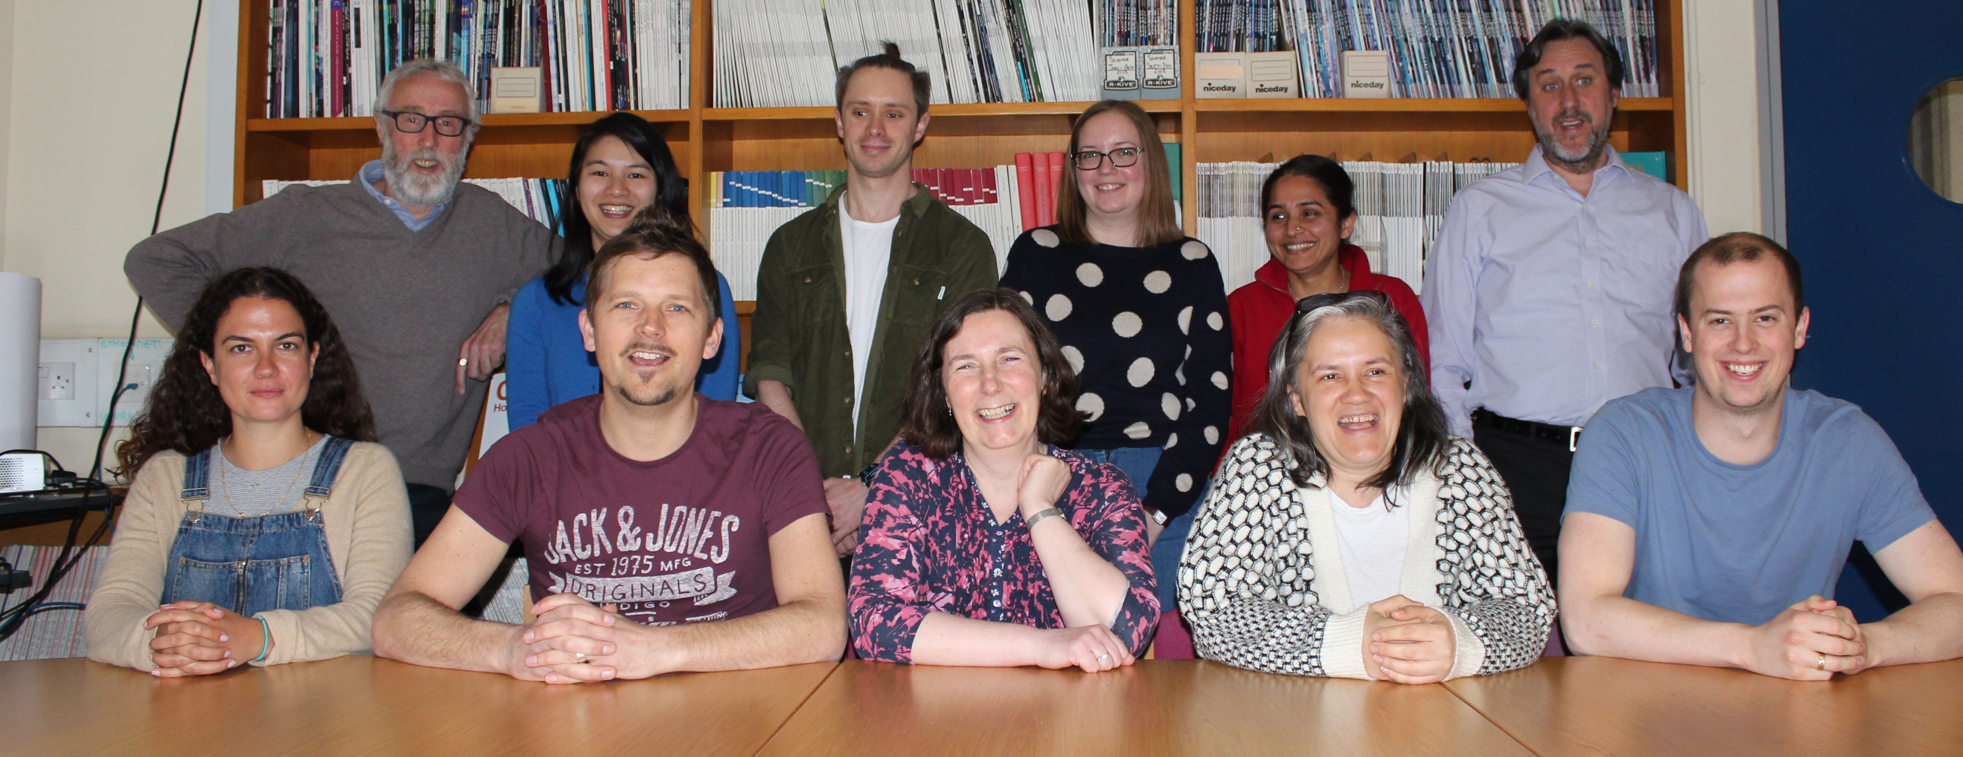
LMCB – PG research institute
ASG; a fantastic Athena Steering Group
enthusiastic – representative – owned areas – good practice
50:50
Notes:
Model gender balance, represent all areas

Slide 5
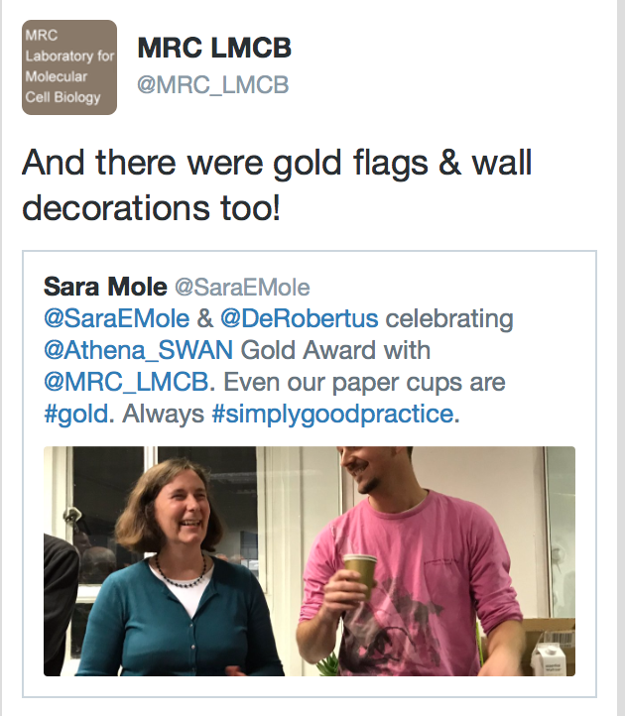
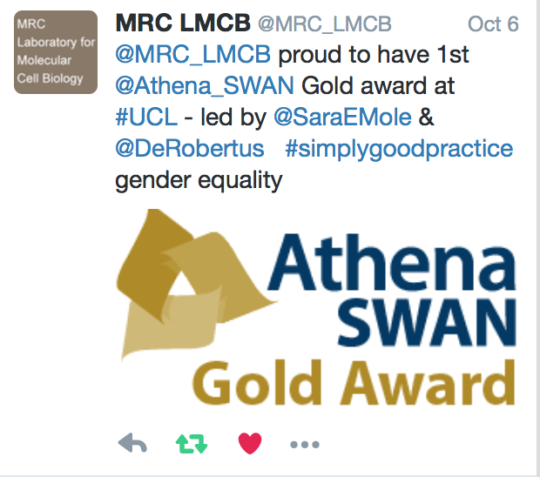
Mantra #simplygoodpractice
Simple
Benefits all - no-one can object (F>M)
Use to inform/assess everything we do
Ask: is it good practice?
No: fix or improve
Use to promote everything we do
Twitter, conversation
Also what others do

Slide 6
LMCB – PG research institute
Our academic pipeline
LMCB
Postgrad
Postdoc
Lecturer
Senior lecturer
Reader
Professor
Postgrad
Postdoc
Lecturer
Senior lecturer/
Reader
Professor

Slide 7
Know our data New - Career tracking next steps

Slide 8
Know our data New - Career tracking to PI / GLs

Slide 9
New procedures = doing things differently (better)
Appraisal checklist – now FLS = Beacon
discussion on career, promotion
Agenda against strategy
Publish minutes
Action tracking
Monitoring progress
Survey every 3 yrs = Beacon

Slide 10
Plugging the leaky pipeline
Academic pipeline
Postdoc Career Development
-Encourage Females to apply*
-Promotion focused Appraisals
LMCB
Postdoc
Lecturer
Senior lecturer
Reader
Professor
*
Postdoc
Lecturer
Senior lecturer
Reader
Professor
Global

Slide 11
Beacon - Encourage Females to apply
Group Leader position recruitment
Talent pool (postdocs) >60% female, only 20% applicants female.
Action: Use less aggressive wording in advert.
Impact: No effect, still only 20% applicants female
Action: Encourage talented female postdocs to apply (positive action)
Impact: 4 females who otherwise may not have applied were offered positions, of whom 3 accepted.
Overall 60% female GLs (3:2 F:M) recruited in recent years
“When I saw the job advert, my initial response was 'I’m not ready for this job yet'. If I hadn’t been encouraged to, I don’t think I would have applied.” Yanlan Mao, new Group Leader, case study

Slide 12
Beacon - Postdoc career development
Training the future Group Leaders & other career paths
Postdocs are >60% female;
Aim to provide 60% F all career paths
Action: Encourage Postdoc training
Survey: Impact
Impact: Increase in awareness and uptake (survey)

Slide 13
Beacon – Future Group Leaders
Action: Career timeline, support fellowship writing, interview practice
Impact: LMCB-trained future group leaders are gender balanced Since 2009, 60% (4/7) Postdocs that successfully established their own groups outside UCL were female.

Slide 14
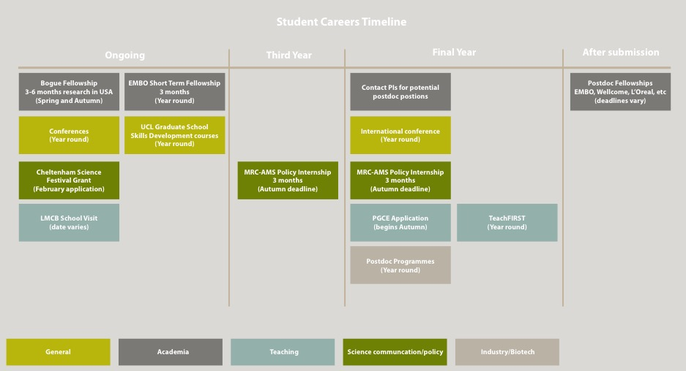
Beacon – Student Career Timeline

Slide 15
Surveys – example of impact

Slide 16
Institutionalising – becoming the norm
The norm – GLs, students & postdocs realise it’s not when move elsewhere
Acting as Beacon & Champion

Slide 17
Unconscious bias: Provide positive role models
‘Someone like me’
Short term:
Raise awareness of hidden bias (excellence not stereotype / like me)
Have procedures, tools and actions in place to minimize bias
Use positive action
Long term:
Unconscious bias is influenced by role models
Provide positive role models: Seminar series, committees, meetings, panels, awards, websites, etc

Slide 18
Beacon - Role models - Identifiable
“The postdoc events are great - they offer a wide range of topics to help postdocs progress in their career, and are also a great way to connect with others”. Julia Petschnigg, Postdoc.

Slide 19
Role models – LMCB seminar series 50:50
Female seminar speakers list
Notes:
We realized this was not because there were no excellent female speakers, but largely, probably through unconscious bias, did not automatically think of female speakers. To help people we provide a list of potential female speakers from the UK and Europe in Molecular and Cell biology, which got us quickly back to 50:50!

Slide 20
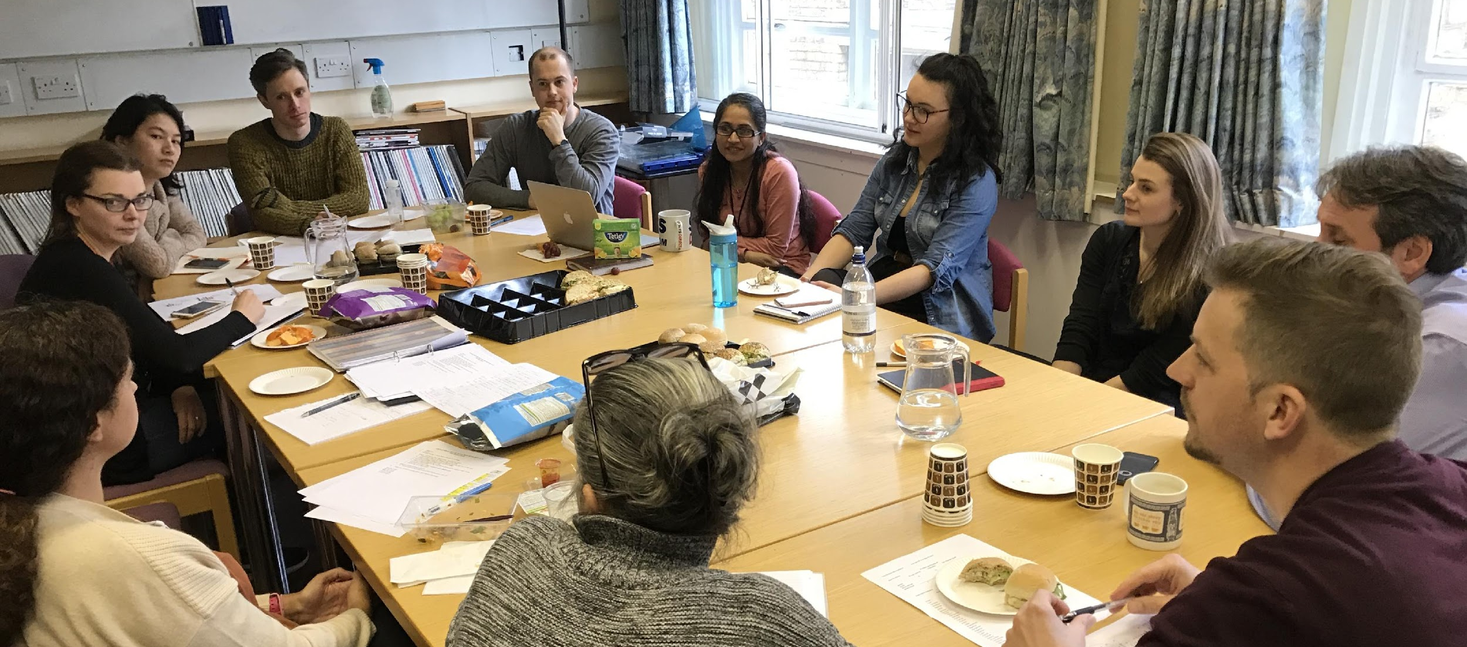
New initiatives
Professional & technical support staff
Multiple disadvantages - protected characteristics
Bullying & harassment
Wellbeing & resilience
UK wide – new PI survey
Supported mentor scheme

Slide 21
UCL : Finishing what Bentham started
#simplygoodpractice
#benefitsall
Equity 50:50
Norm for next generation
Processes to facilitate equity by established leaders

Slide 22
Top tips
Gather your enthusiasts
Know your data
Find your vision
Identify your priorities
Fix what is in your (immediate) power to change
Plan actions to address priorities
Implement and keep up the momentum
Keep communicating the vision
Monitor for impact
Don’t reinvent the wheel
Keep deepening and start to beacon

