Slide 1
Biomedical Sciences
Applying for Medical Sciences
A summary of the
application process
www.ed.ac.uk
applyedinburgh

Slide 2
Standard academic entry requirements
Biomedical Sciences
Most common
SQA Qualifications: Nat 5 – English at grade C and Mathematics at grade B. Highers: AAAB-ABBB by end of S5 or AAAA-AABB/ABBBB by end of S6. BBB must be achieved in one year of S4-S6. Must include Biology and Chemistry (Maths and Physics are recommended as are Advanced Higher Biology and Chemistry)
Year 2 entry: AB at Advanced Higher in Biology and Chemistry (either way around)
GCE Qualifications: GCSE – English at grade 4/C and Mathematics at grade 6/B. 3 x A Levels in one set of exams at grades ABB to include Biology/Human Biology and Chemistry (Mathematics or Physics are recommended).
Year 2 entry: AAB at GCE A Level to include Biology and Chemistry in one set of exams
International Baccalaureate: 36 points with 665 at HL-32 points with 655 at HL. HL must include Biology and Chemistry, one at grade 5 and one at grade 6 (Mathematics or Physics are recommended). SL English and Maths both at grade 5 (we accept both Analysis & Approaches and Applications & Interpretation)
Year 2 entry: 36 points overall with 666 at HL to include Biology and Chemistry
We also accept a range of international qualifications and requirements can be
Found here: https://www.ed.ac.uk/studying/international/country
www.ed.ac.uk
applyedinburgh

Slide 3
Standard academic entry requirements
Biomedical Sciences
Most common
Czech Republic: Award of Maturitni Zkouška, which must include at least four Maturita exams, with grade 1 in two subjects, including Biology and Chemistry, and grade 2 in remaining subjects.
French Baccalaureate (FB) at grade 14 or above overall, with 14 in 3 subjects including Biology and Chemistry.
Germany: Award of Abitur with overall average grade of 1.7 with grade 12 in three Advanced Level subjects including Biology and Chemistry. We also accept a grade 12 in English Language in the Abitur to prove English language proficiency.
Ireland: Award of ILC with Grade H1/A1 at Higher Level in one subject, Grade H2/B1 in two subjects and Grade H3/B3 at Higher Level in two subjects to include Chemistry and Biology. We require English at grade C (Higher Level)and Maths at grade B/Higher Merit (Higher Level) in the Junior Certificate.
Italy: Pass L’esame di Stato (opzione Classica/Scientifica) with 90/100 overall including Chemistry & Biology
Poland: Award of Matura with Extended level subjects two at 80% and one at 85%, to include Biology and Chemistry at either grade. We also accept 70% in English Language at Extended Level in the Matura as proof of English language proficiency.
Slovakia: Award of Maturitna Skúska/Maturita with grade 2 (very good) in three subjects and a grade 1 (excellent) in one further subject; including Biology and Chemistry at either grade.
Spain: Titulo de Bachiller with 8.5 overall with 8.5 in two subjects and 9 in one futher subject; including Biology and Chemistry at either grade.
If English is not your first language proof of English language proficiency is also required
We also accept a range of international qualifications and requirements can be
Found here under the heading of Biomedical & Medical Sciences: https://www.ed.ac.uk/studying/international/country
www.ed.ac.uk
applyedinburgh

Slide 4
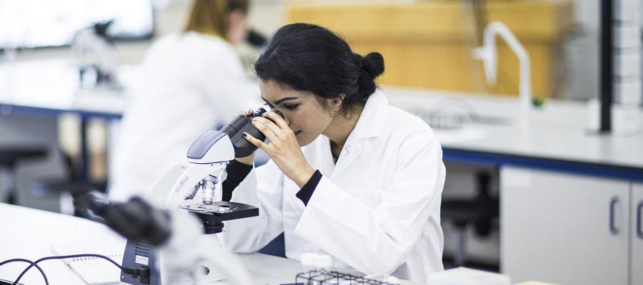
Personal statements
In terms of your personal statement you need to express your interest in the programme you are applying to as well as telling us a bit more about yourself. So, we’re looking for the following:
Medical Sciences mentioned as your top priority;
Indication of the importance of/give examples of science in healthcare;
Awareness of importance of medical research
Mention career plans;
Any relevant work experience (lab based);
Explain the relevance of any work experience you’ve undertaken to the study of medical sciences;
Mention any other interests showing responsibility/representation of you as a person
We know that during the Covid-19 pandemic it may be very difficult to obtain lab-based work experience/shadowing. Relevant experience can also be obtained by: talking with those working within the field; reading/watching/listening to medical science themed literature/digital content/articles.
Biomedical Sciences
www.ed.ac.uk
applyedinburgh

Slide 5
Widening participation
Biomedical Sciences
We offer extra support for applicants who:
Are care experienced
Reside in geographical areas defined as “deprived”
Attend a school of low progression to Higher Education and / or low attainment
Have significant caring responsibilities
Are refugees or asylum seekers
Have participated in recognised access programmes (ie SWAP)
www.ed.ac.uk
applyedinburgh

Slide 6
Further information:
Widening Access offers
Biomedical Sciences
Eligibility criteria for our contextual “flags”:
www.ed.ac.uk/studying/undergraduate/access-edinburgh/widening-access-offers
Online Widening Access eligibility checker (please check this has has been updated for 2021 entry applicants – this should happen in early September 2020):
https://admission-checker.is.ed.ac.uk/
Degree Finder (outlining the minimum academic entrance requirements for Widening Access applicants):
www.ed.ac.uk/studying/undergraduate/degrees
www.ed.ac.uk
applyedinburgh

Slide 7
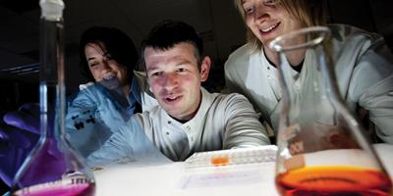
Biomedical Sciences
What happens to my application?
Overview
How we receive your application - UCAS
Assessing your application: Screening
Decision making – Offers
Post offer
www.ed.ac.uk
applyedinburgh

Slide 8
Biomedical Sciences
How we receive your application
www.ed.ac.uk
applyedinburgh

Slide 9
Assessing your application
Biomedical Sciences
Screening
Our team check all the applications to make sure they meet the entry requirements before all are assessed by two members of staff independently
If we need clarification of any details or missing information we will contact you through EUCLID for further information.
Euclid sends automated emails so please regularly check your EUCLID portal for updates and requests for information
Please ensure your academic referee provides us with ‘predicted’ final grades if you have yet to sit your final examinations. ‘Predicted’ final grades are the grades your academic referee thinks you will be able to achieve in your final exams based on how well you have performed in each subject up to that point.
www.ed.ac.uk
applyedinburgh

Slide 10
Decision making
Biomedical Sciences
Once we’ve assessed applications and where necessary ranked them in order of performance; we decide how many offers we can make. We will always make more offers than we have places as we know some people will choose not to accept their offer from us.
All offers are made via UCAS and can be either Unconditional (if you have already met all of our requirements; including English language) or Conditional (if you have yet to meet our requirements)
We know it can sometimes be difficult to decide where to study if you receive more than one offer so we hold Offer Holder days so that you can talk with current students and ask more about what it’s like to live and study in Edinburgh.
www.ed.ac.uk
applyedinburgh

Slide 11
Post offer
Biomedical Sciences
What happens now?
If accepting the offer as firm
You’ll be asked to upload scanned certified copies of documents
Apply for accommodation
If accepting the offer as insurance
Nothing further to do at this time
We will contact you further if you then make us your firm choice.
www.ed.ac.uk
applyedinburgh

Slide 12
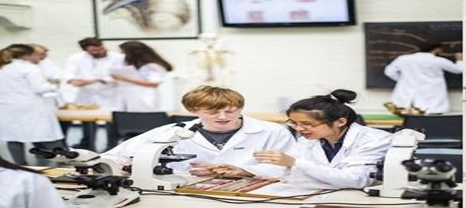
And finally…
Biomedical Sciences
Exam Results – July/August
Confirmation – have you met the conditions of your offer?
Biomedical Teaching Organisation communication – issued to firm applicants who meet their conditions of offer.
Welcome Week - introduce you to Edinburgh and the Biomedical Teaching Organisation.
Congratulations – you did it!
www.ed.ac.uk
applyedinburgh

Slide 13
Stepping stone to Medicine
Biomedical Sciences
On completion of your degree as well as beginning a career in research or many other options; this programme is also a suitable stepping stone onto the study of Medicine
Our Medical Sciences programme here at Edinburgh covers our first year of study in Medicine so graduates of our programme who have achieved a 2:1 (Hons) or better have the opportunity to apply. Then if successful they would enter our Medicine programme in Year 2.
This can cut down the total length of study by as much as 3 years as follows:
Enter our Medical Sciences programme in Year 2 (depending on high school results) – study Medical Sciences for 3 years
Apply to our Medicine programme and if successful enter in Year 2 (Year 3 is not compulsory for those with a research based degree so skip this) – jump then to Year 4 and complete your Medicine studies in full within 4 years
Total length of study = 7 years (3 years Medical Science + 4 years Medicine) – this in only one year more than if you entered our Medicine programme directly from high school!
www.ed.ac.uk
applyedinburgh

Slide 14
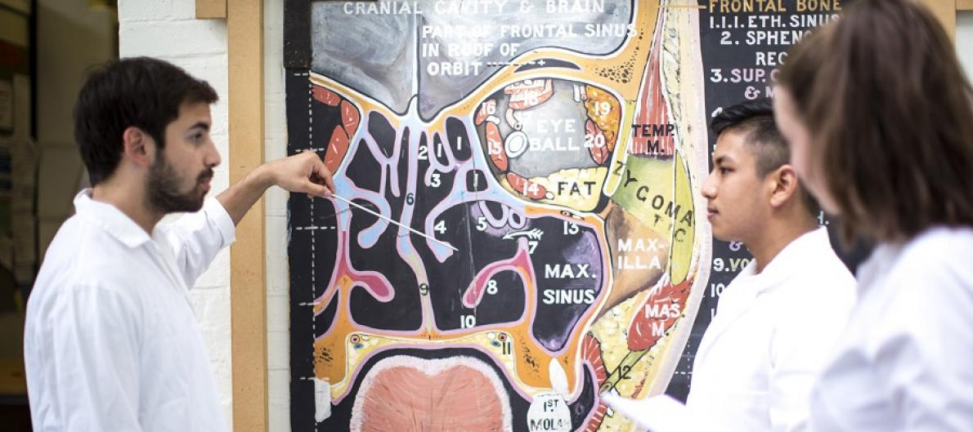
Useful websites
Biomedical Sciences
Edinburgh Medical School – Biomedical Sciences:
https://www.ed.ac.uk/biomedical-sciences/undergraduate-studying/bsc-hons-medical-sciences
Twitter:
https://twitter.com/bmtoEdUni
Facebook:
https://www.facebook.com/biomedscied
www.ed.ac.uk
applyedinburgh

Slide 15
Any questions?
Please email
medug@ed.ac.uk
Biomedical Sciences
www.ed.ac.uk
applyedinburgh
Notes:
Open for questions

