Slide 1

The Swan in Athena SWAN
A peek under the surface
Sue Fletcher-Watson
September 2018

Slide 2
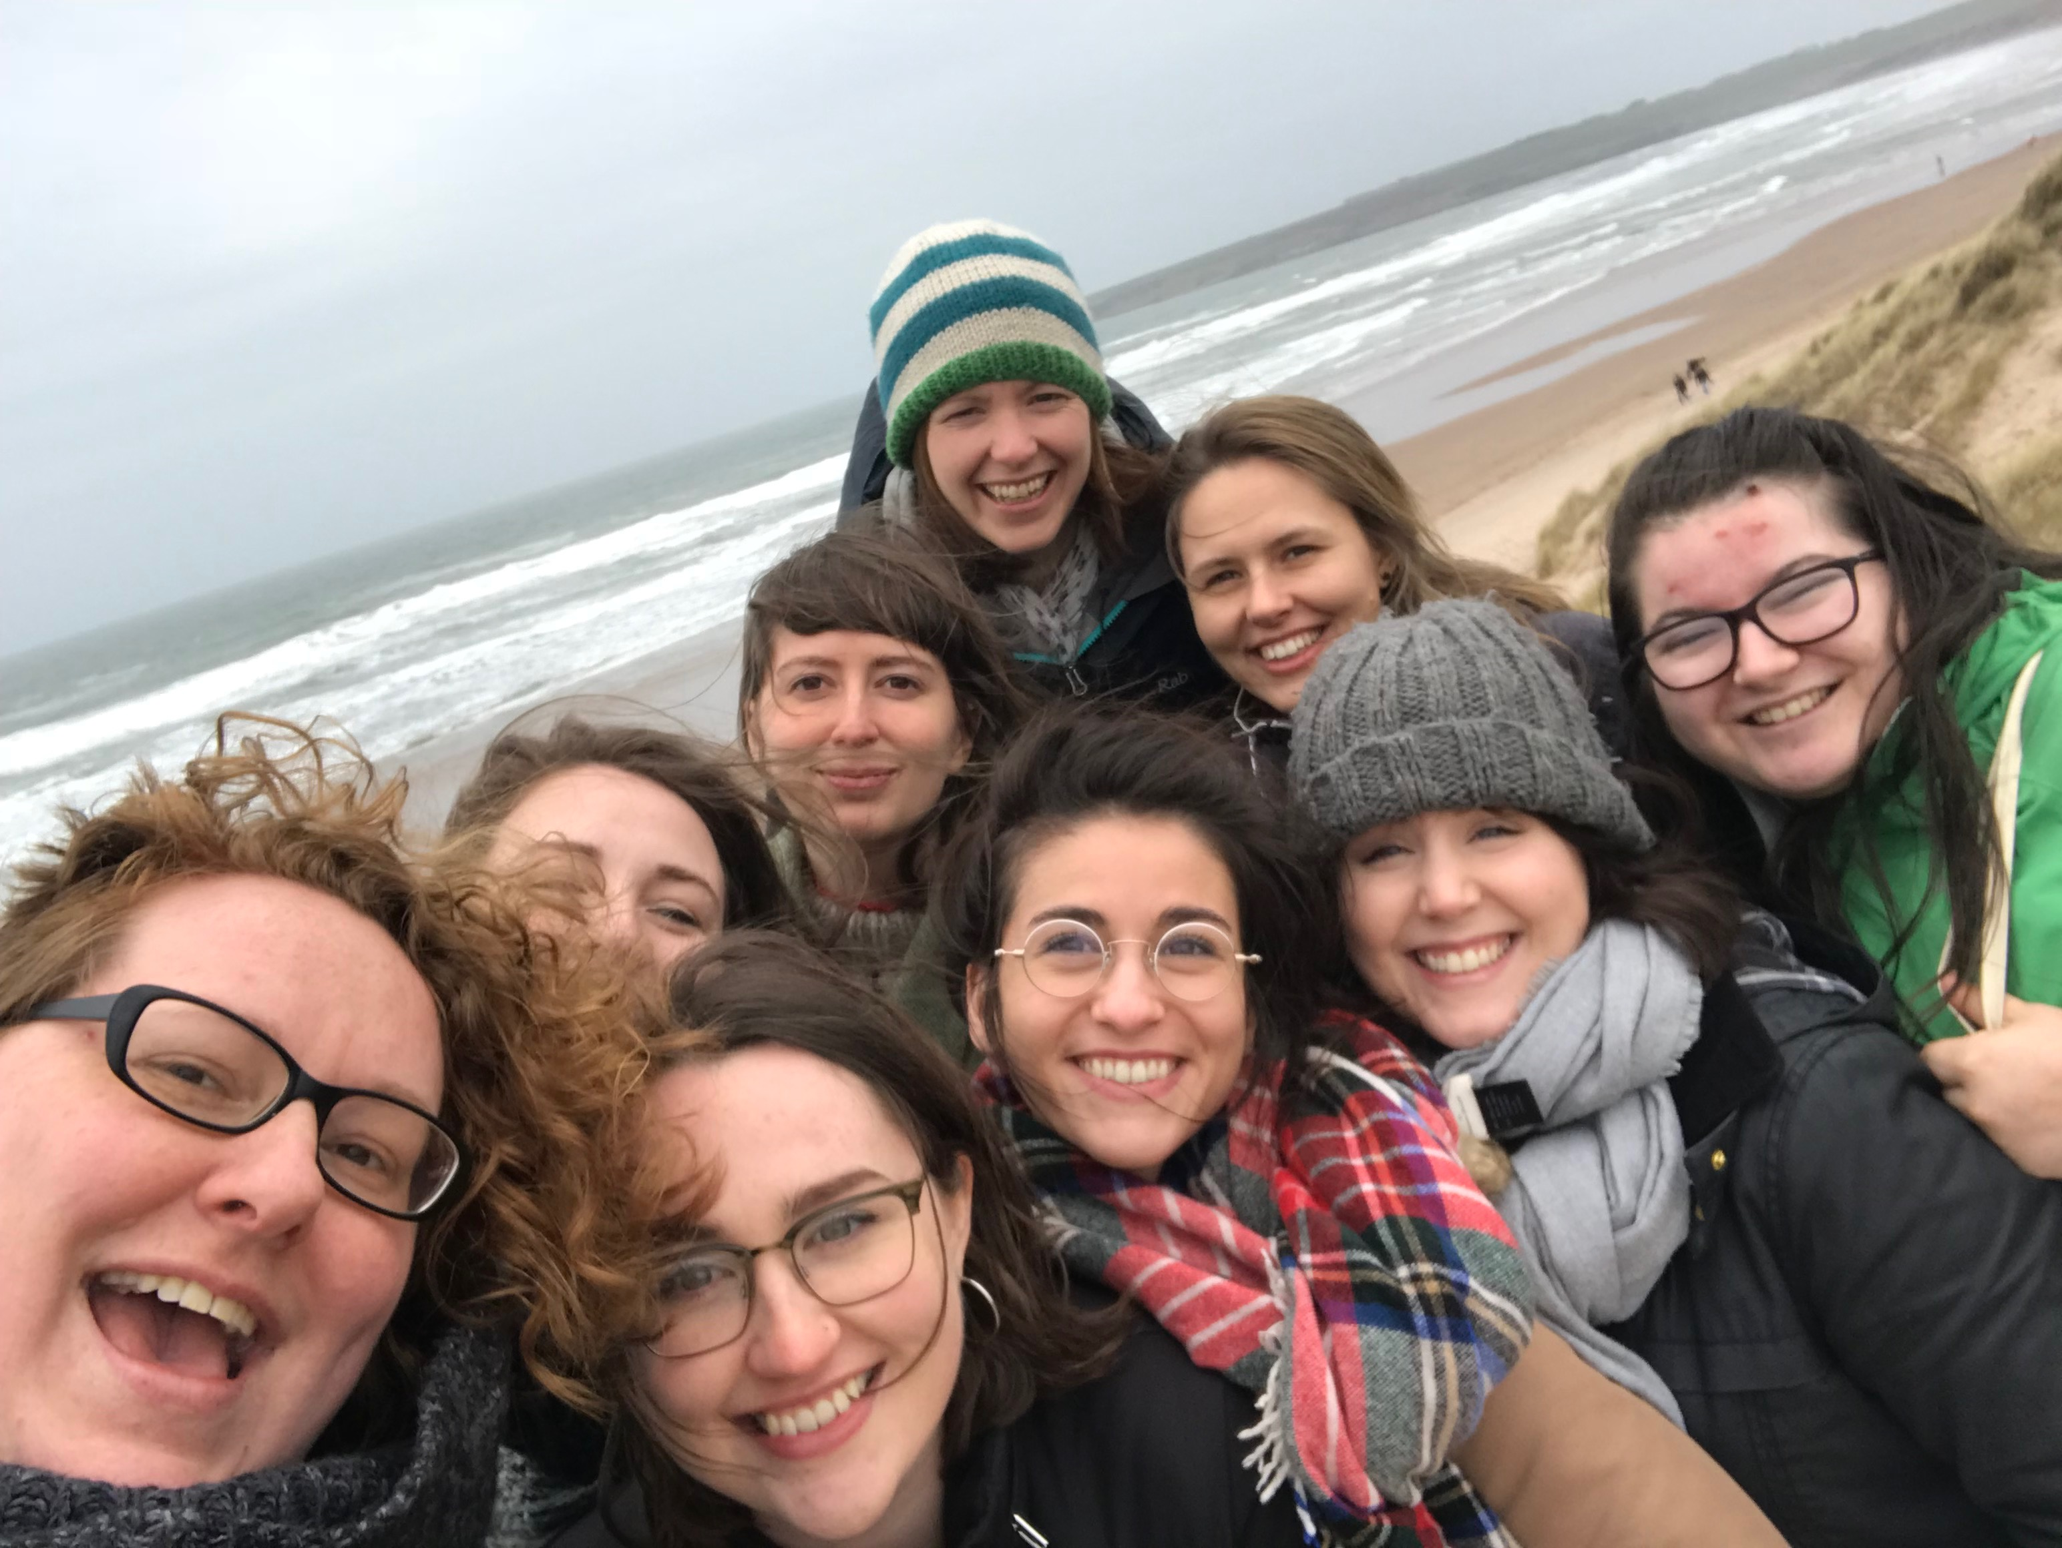
Who am I?
Developmental psychologist, research on (atypical) development
Edinburgh Scientific Academic Track: Chancellor’s Fellow, 10 years post-PhD
Run a lab with 14 members: PhD students, RAs, post-docs
Chair of the Athena Swan Careers, Equality and Progression sub-committee for Clinical Sciences and MolGenPop
Flexible working: mother of two kids, 7 and 9 years old
Partner working in academia
Founder of SuperTroop

Slide 3
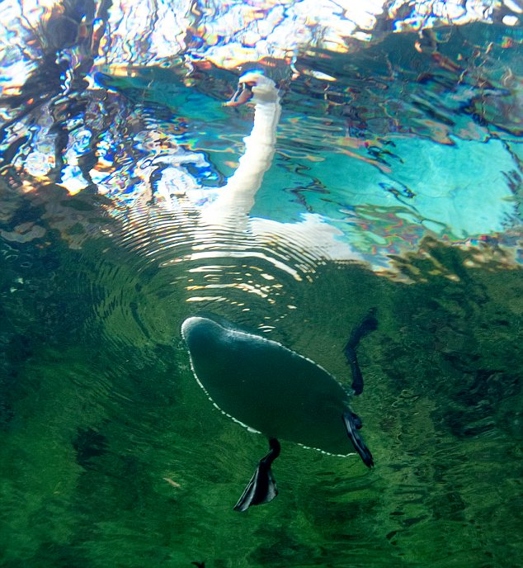
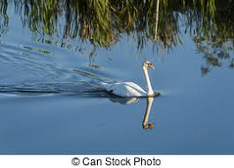
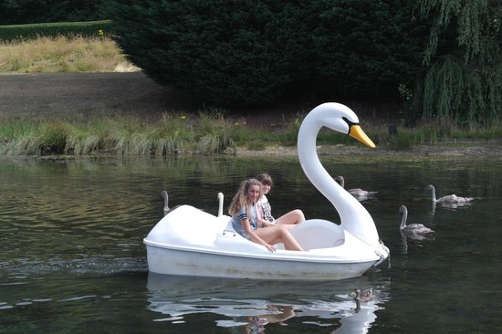
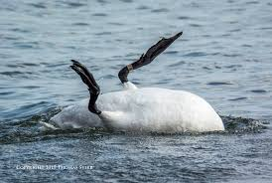

Slide 4


Personal challenges
Supportive spouse (who changed jobs)
Passion + I guess you just get used to it?
Supportive team
Code of conduct, evolving practices
Juggling work and family
Fixed-term contracts
Rejection at work
Lab growth and well-being
Are these gendered issues?

Slide 5
CEP goals
Goal: to identify challenges and provide solutions in career development, that allow each person to meet their professional goals
Gender imbalance is
a sign that processes might not be as equal as we’d like
a failure to cultivate a strong, diverse workforce
Solutions
Identify potential sources of bias / drivers of inequality and eliminate these
Correction against outside forces: e.g. gendered expectations; role modelling
What does success look like?
Diversity, but not adherence to rigid targets
People are happy and confident at work
Notes:
Drivers of inequality = department journal club on a Friday afternoon. Could disproportionately affect women so long as women are doing more school pick ups.

Slide 6
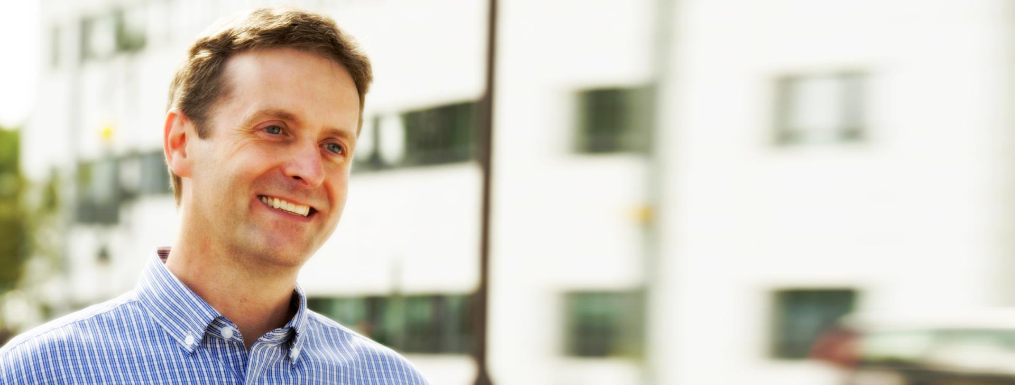
CEP achievements
Egalitarian promotions process (on the whole)
Checklists to support better recruitment and P&DR processes
Paternity leave extension & encouraging uptake
Good gender balance in postgraduate taught and research programmes, including staff scholarship scheme
Effective mentoring scheme

Slide 7


CEP challenges
Buy-in, reporting and preaching to the choir
Gender imbalances at the highest grades: what do they mean?
Reaching out to under-served groups
  Clinical academics
  Professional services
Exploring gender balance during the PhD pathway
Intersectionality
Events like this + local champions
Understanding top-level promotions & eliminating sources of bias
CEP membership
  Recruiting mentors
  Workshop on barriers & solutions
Data on PhD interview, supervision and viva panels
Cross-talk with other staff networks

Slide 8
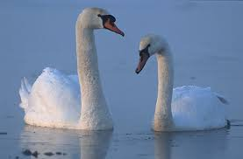
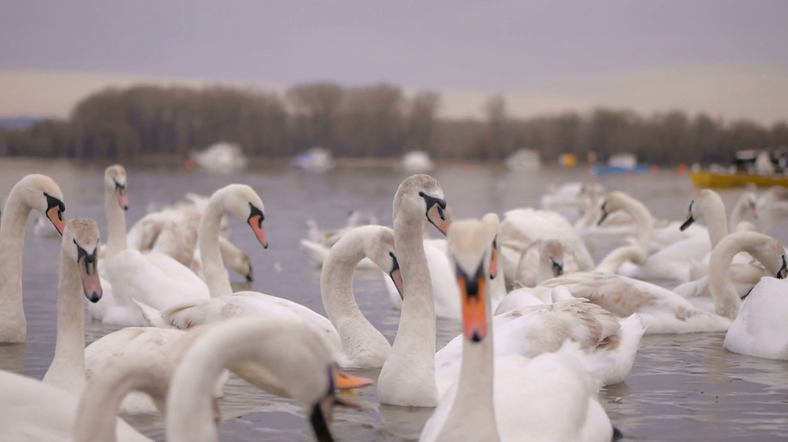
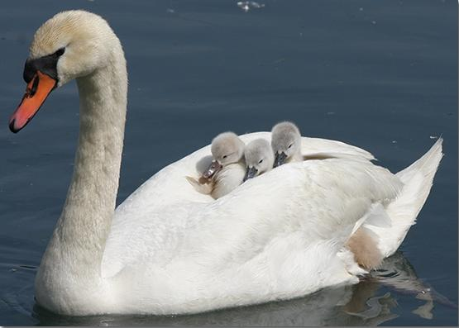
Thank you
www.dart.ed.ac.uk @SueReviews
https://www.ed.ac.uk/medicine-vet-medicine/edinburgh-medical-school/athena-swan

Slide 9
The DART Code of Conduct principles for a happy workplace
Be kind
At the DART lab we value camaraderie. Be generous to each other, and to everyone we encounter in our work.
Be inclusive
Educate yourself to recognise and accept differences between people. Try not to rush to judgement, make assumptions or impose your personal norms.
Ask for help
Our workplace is a safe space to be vulnerable, and to learn new things. Be attentive to what other people need from you.
Share
Share your knowledge - explain things to each other patiently. Take care of our shared spaces and resources.
It’s OK to say no
Try to make your requests reasonable, and don’t trespass on others’ goodwill. Feel free to say No when you need to focus on your own work, your family & friends, or yourself.

