Slide 1
Benefits and costs of always saying yes: my career story
Emily Sena
@drEmilySena

Slide 2
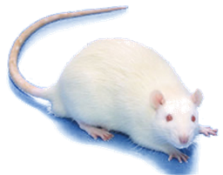
A bit about me….
Senior lecturer (tenure-track post)
Meta-research scientist
I research research practices to inform evidence-based improvement strategies
Focus on animal models of human diseases (stroke)
I considered saying
Black women in academia

Slide 3
Career timeline
2001
2001
2003
2005
2007
2009
2011
2013
2015
2017
2018
Today
Bsc (Hons)
1357 days
PhD
1703 days
519 days
Post-doc
Split post-doc
1096 days
Research Fellow
1217 days
141 days
Senior Lecturer

Slide 4
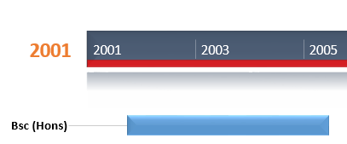
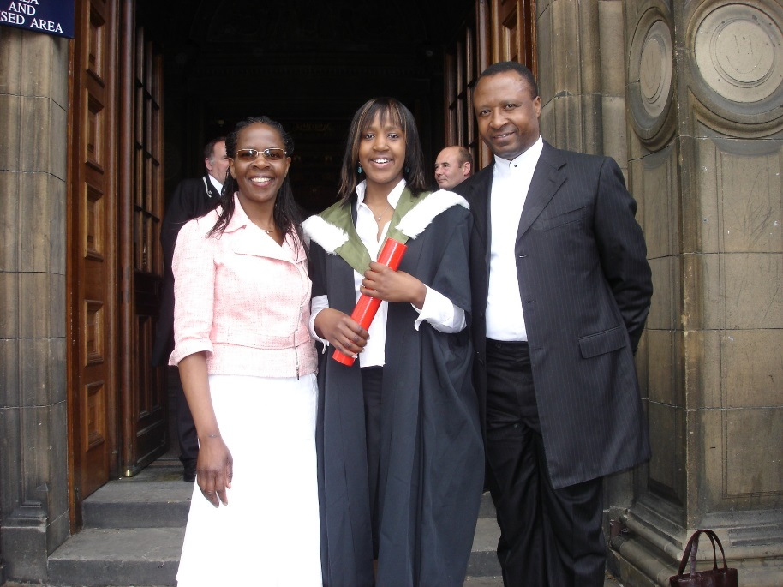
The start of my journey

Slide 5
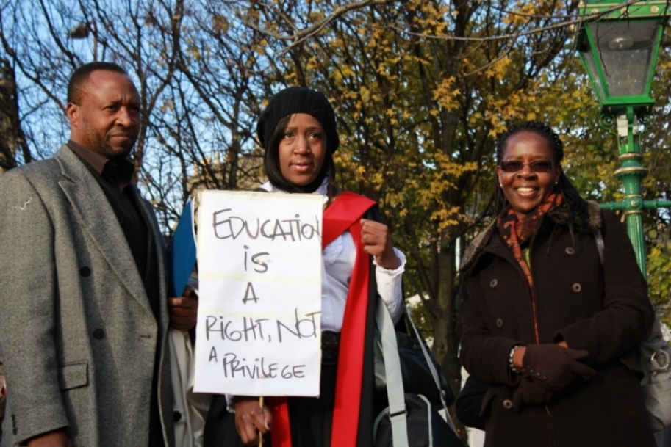
The start of my journey

Slide 6
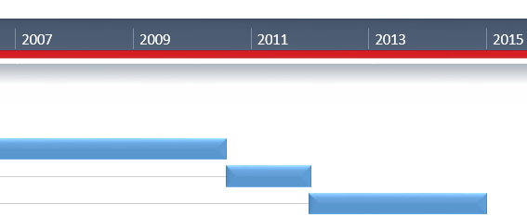
A big
Australia
Benefits
Network/collaborations
Wet lab
Academia in another country
Travel
Food & wine
Working on my tan
Found my equality voice
Costs
Nomadic existence
Very unsettled
Poor
Single

Slide 7
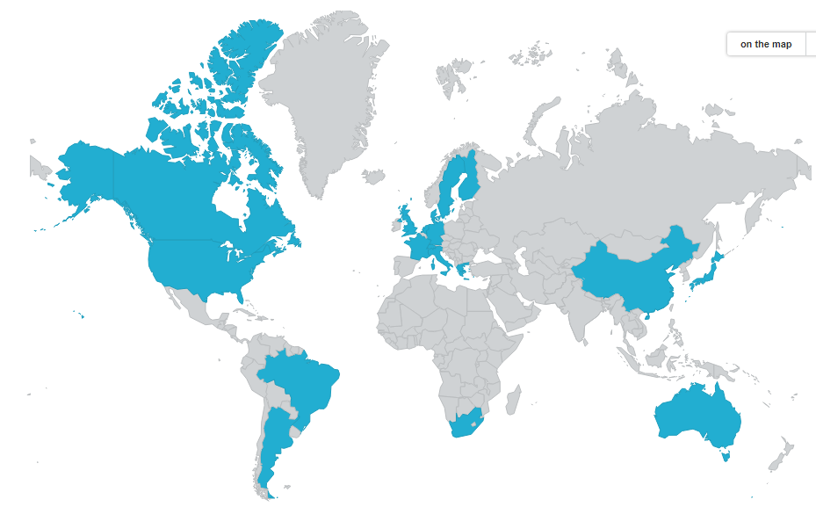
More
Benefits
72 Publications (h-index 36)
Demonstrate effective collaborations
Coordinating projects
Working with different personalities
Broaden knowledge base
Costs
52 middle author papers
Jack of all trades/master of none
Can be frustrating
Lack of control

Slide 8
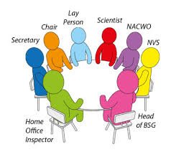
Even more
Flattery
Peer review requests
Speaker invitations
15 talks outside of Edinburgh for 2018
Board/committee membership
Benefits
Marker of esteem
Establishing my independence
Representation
Challenging
Impact
Confidence building
More travel
Costs
Time (prep and travel)
Jet-lag
Not recognised as much
Guilt

Slide 9
An even bigger
6-month residential fellowship (2016-2017)
Benefits
Interdisciplinary academic environment
Protected time to think/time-out
Improved my German
Didn’t have to move house
Travel-ban
Costs
Personal (away from Scott)

Slide 10
Why so much ?
I didn’t understand the black box that is academic promotion
FOMO
Scared of letting people down
As a black woman, I feel like I have to work harder to represent

Slide 11
Learning to say
Mentorship
Malcolm Macleod, Siddharthan Chandran, Hilary Critchley, Moira Whyte, Catriona Maccallum
Compromise/learning your value
Things can be on your terms
Science citizenship is important but so is self preservation and balance
You know your limits bests
You will be asked until you say no!

Slide 12
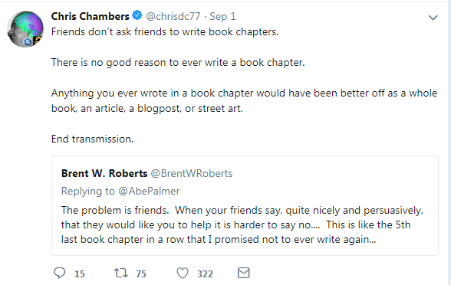
But saying is not easy

Slide 13
An important
Offered a PI position in Berlin
Independence
Research team
Generous package
City that I love
Opted for
A city I love more
Research environment most suited to me
A happy home life
No security (post-doc)

Slide 14
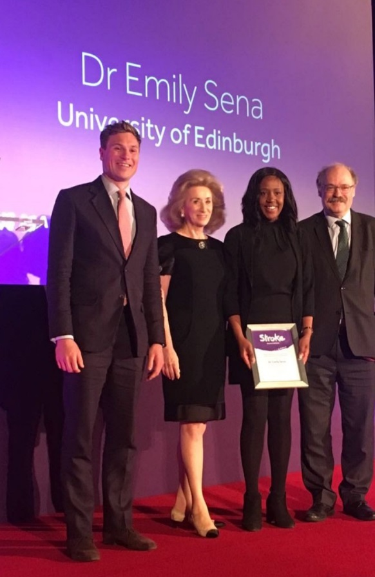
Sometimes offers better
Stroke Association funded senior lectureship
Stay in Edinburgh
Advance my career
Settled and happy home life
Support from CCBS, Cathy Abbott
22 support letters from my network

Slide 15
Reflections
There were far too many yeses
Clear long term benefits (seat at the table, support)
Not black and white
Negotiate and control
Prioritisation is key
Time to resign from some boards
Objective for 2019 – 6 external talks

Slide 16
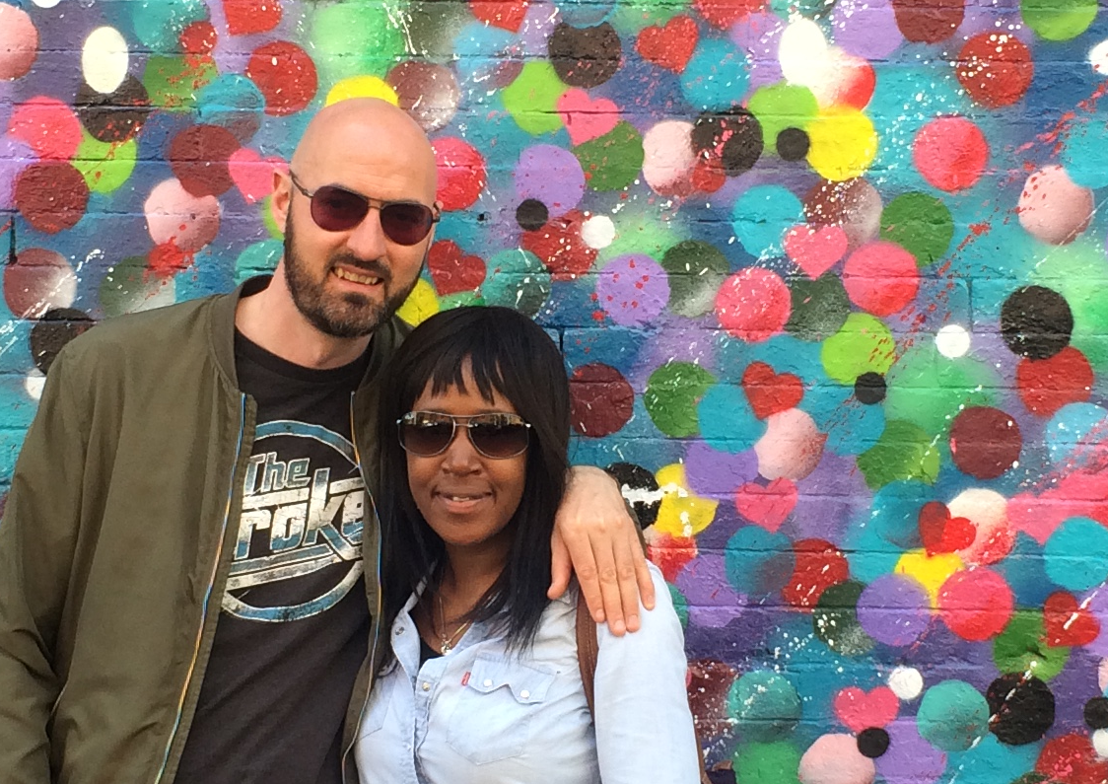
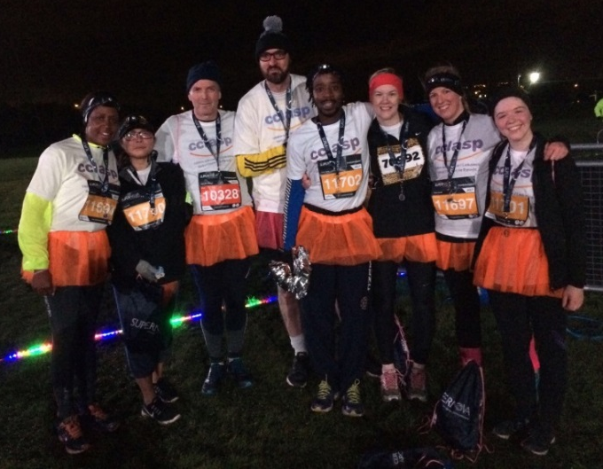
Thank you!

