Slide 1

What Is It Like To
Have Visual Imagery?
Fiona Macpherson
fiona.macpherson@glasgow.ac.uk

Slide 2
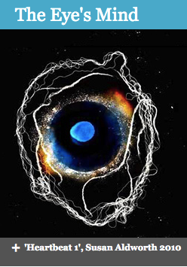
What is it like to have visual imagery?
How does visual imagery differ from visual experience?
How can we best communicate the answers to these questions to people who have (congenital) aphantasia?

Slide 3
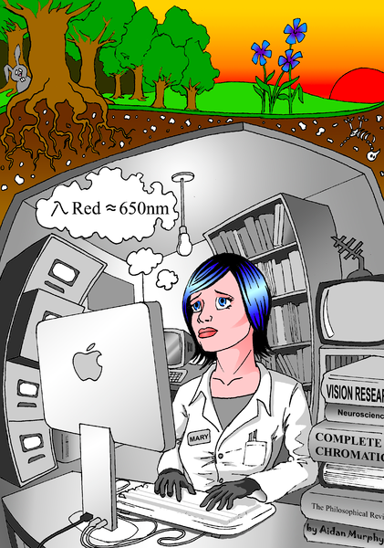
Many philosophers have thought that if you have never experienced something, then you cannot know what it is like to have that experience.
E.g. Frank Jackson’s Mary.
If that is right then those with aphantasia, who have never had an imagery experience, cannot know what it would be like to have one.

Slide 4
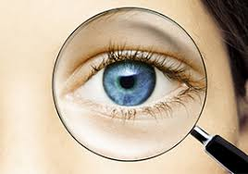

What is visual experience?
We are fairly familiar with describing our visual experiences.
We say things like, ‘it looks to me as if there is a bear behind a tree’.
Conscious vision involves having a visual experience in virtue of which we we become aware of the world.
While visual experience can be accurate it can also be inaccurate, for example in illusion and hallucination.
We recognise similarities between visual experience and visual imagery and give similar descriptions of our visual imagery.

Slide 5

How do visual experience and visual imagery differ?
David Hume famously said that visual imagery is less “vivid” and “lively” than visual experience.
Those words have echoed down the ages and are frequently repeated today.
To many people these words strike a chord and point towards some difference between typical visual experience and visual imagery.

Slide 6
However, it is not clear that those claims are literally true.
Consider “lively”. Experience is not literally lively, so the use of this word is metaphorical.
It is not clear how we can say non-metaphorically what is meant.
Consider “vivid”.
The content of experience can be more or less vivid, in a straightforward use of the term, meaning colourful and bright.
Colourful scenes brightly illuminated are more vivid than grey scenes, barely illuminated and shrouded in fog.
And one might extend the use of this term and speak of the corresponding experiences of these scenes as more or less vivid.

Slide 7
But in this sense of the term “vivid” it is not clear that visual experience is more vivid than imagery!
A visual experience of a dull grey London fog would be less vivid than visual imagery of brightly coloured balloons and streamers in a parade.
A visual experience of a dog on a beach and visual imagery of the same scene would be equally vivid on this account.
So we need another sense of the term “vivid” if we are looking to capture the thought that visual experience is more vivid in general, in some sense, than visual imagery.
But no one has identified what that might be.

Slide 8
Moreover, sometimes visual experience is not more lively and vivid than visual imagery.
People with hyperphantasia report that their imaginative experience is every bit as lively and vivid as perceptual experience.
I’ll set aside hyperphantasia for the rest of the talk, and talk of ‘typical’ imagery, about which most people agree that it is in some sense less lively and vivid than visual experience.

Slide 9

So if we can’t use “lively” and “vivid” in their ordinary literal senses to capture what visual imagery is like:
are we stuck with not being able to explain to congenital aphantasics what it is like to have it?

Slide 10
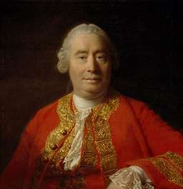

Hume famously pointed out two counterexamples to the idea that if you haven’t had an experience you can’t know what it is like to have it.
You can come to know what it would be like to experience something that you have never experienced by
(1) recombining ideas of things that you have experienced.
E.g. a golden mountain
(2) experiencing things very similar.
E.g. the missing shade of blue

Slide 11

Can we give aphantasics knowledge of what it is like to have visual imagery when they haven’t experienced it by using Hume’s methods?
And, in so doing, can we get a better grip on the nature of visual imagery and how it differs from perceptual experience?
Yes!
Look at anomalous visual experience.

Slide 12


In modal completion you have a visual experience as of an object in virtue of experiencing edges that appear to be created by a luminance, colour or texture boundary.
At the same time, you often know that there is no such boundary and there is not a difference in luminance, colour or texture where there appears to be one; but, nonetheless, that is what you experience.

Slide 13
When you realise that the shape that you are experiencing is not really there, you have an experience that is somewhat like having visual imagery:
you experience something but, at the same time, you realise it isn’t really in the world before you.
To the best of my knowledge aphantasics experience amodal completion.

Slide 14
But there are differences:
You can shift your attention in a way that reveals the unreality of the apparent shape or edge.
Often this is what makes you realise that those contours are illusory.
This is not true of visual imagery.
In having visual imagery you don’t have first have an experience of that which the imagery represents and then a different experience that tells you that content is not really present, which convinces you that the first experience was illusory.
Instead, you are just aware of the content of your imagery and during its persistence you know that it does not reflect reality.

Slide 15
(b) Modal completion experiences lack the voluntary nature of typical imagery.
You can, to some extent, voluntarily choose to switch back and forward between experiencing the illusory contour and experiencing that it is really not present, but you cannot choose voluntarily to experience whatever you want.

Slide 16
(d) In my opinion, modal completion experiences seem more like a visual experience—more “vivid” —than visual imagery.
Of course in having such visual experience you aren’t seeing accurately, and you usually come to learn through the process described above that you aren’t.
However, the experience still seems far like more seeing, rather than imagining.

Slide 17

Known Afterimages
Like imagery, in many cases, afterimages don’t appear to present objects existing in the environment.
But unlike typical imagery, afterimages are not voluntary.
In my opinion, afterimages are more “vivid” than visual imagery, but they are a slightly less vivid than a standard visual perceptual experience.

Slide 18

Lucid Dreams
Some aphantasics have visual dreams and some do not.
Comparing visual imagery to dream experiences will not be helpful to those aphantasics who don’t dream.
But for those that do: is dreaming like having visual imagery?
Normal dreams present things as existing here and now —so are quite unlike typical visual imagery.
But in lucid dreams people have insight into the fact that they are dreaming, so they know their experience doesn’t reflect reality — like having visual imagery.

Slide 19
Many lucid dreamers claim to be able to determine the content of their dreams.
This makes them like visual imagery with respect to voluntariness.
Are dreams more “vivid” in the special sense than visual imagery?
An interesting feature of dreams is that when one has them one usually takes them to be perception, and thus like perceptual experience, but when one wakes up and recalls them, one seems more aware of their dissimilarity to visual experience than one did at the time of having them.

Slide 20
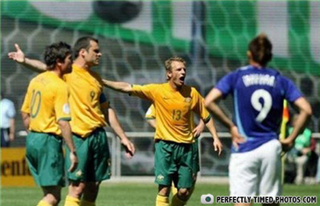
Amodal Completion
It occurs when part of an object is experienced as occluded and is reported as having a particular shape or boundary, yet the occluded portion of the object is not experienced as being defined by colour, lightness or texture boundaries.
Unlike modal completion, the occluded amodally completed object’s parts do not appear within our experience in virtue of a colour or lightness boundary. Yet, still, in some sense they seem present.

Slide 21

Do amodal completion experiences present their objects as existing?
Cases vary!
The cat – yes!
Other cases:
When you attend to the Kanizsa figure you realise that there isn’t really a downward facing triangle present, only the three angles.
This case of amodal completion is therefore quite like cases of visual imagery. The object is present in your experience but it doesn’t seem present in the world.

Slide 22

Amodal completion is often unlike typical visual imagery experience as it lacks voluntariness.
Amodal completion is often constrained by the world with respect to what amodally completed experiences one has.
You are not free to voluntarily experience what you wish.
When looking at the Kanizsa triangle you can’t help experiencing a downward facing triangle.
You cannot experience whatever path you want between the ends of the angles, such as curved lines.

Slide 23
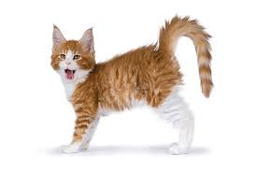
Amodal completion is sometimes less determinate than modal completion.
In modal completion the completed edges are given to you in your experience by lightness or colour boundaries, which establishes a high level of determinateness.
In some amodal completion, like the downward pointing Kanisza triangle, the world and the visual system fix things quite determinately.
But in others there can be wiggle room
for indeterminateness
—which makes it like visual imagery.

Slide 24
What about vividness?
Similar to the case of typical visual imagery, in amodal completion there is the sense that you are clearly not seeing the full contour or occluded part of object, yet in some sense you are aware of the contour and occluded part.
This makes amodal visual completion quite like visual imagery in respect of vividness.

Slide 25
Might amodal completion just be a case of imagery?
One reason to resist:
To the best of my knowledge aphantasics can experience amodal visual completion.
Yet, they lack visual imagery.
So amodal completion isn’t imagery!

Slide 26
But maybe aphantasics only lack voluntary imagery, and amodal completion is involuntary imagery.
Sometimes aphantasics report imagery involuntarilty arising.
And the occurrence of dreams in some aphatasics is sometimes cited as evidence of aphantasics having involuntary imagery.

Slide 27
There’s lots more to think through about whether this is a case of imagery, such as the nature of the underlying mechanisms that produce the effect.
That’s the task for another day.
Today the goal was to honing in on a series of experiences that are, phenomenally, like visual imagery.
And I hope that I have done that here.

Slide 28
Conclusion
I set out to answer:
What is it like to have visual imagery?
How does visual imagery differ from visual experience?
How can we best communicate the answers to these questions to people who have aphantasia?
I answered this by
—outlining a series of experiences that are like visual imagery in certain respects
—in the hope that this will allow people (inc. congenital aphantasics) to triangulate and extrapolate to come to a better understanding of what it is like to have visual imagery.

Slide 29

If you like illusions see:
www.illusionsindex.org

